Slide 1
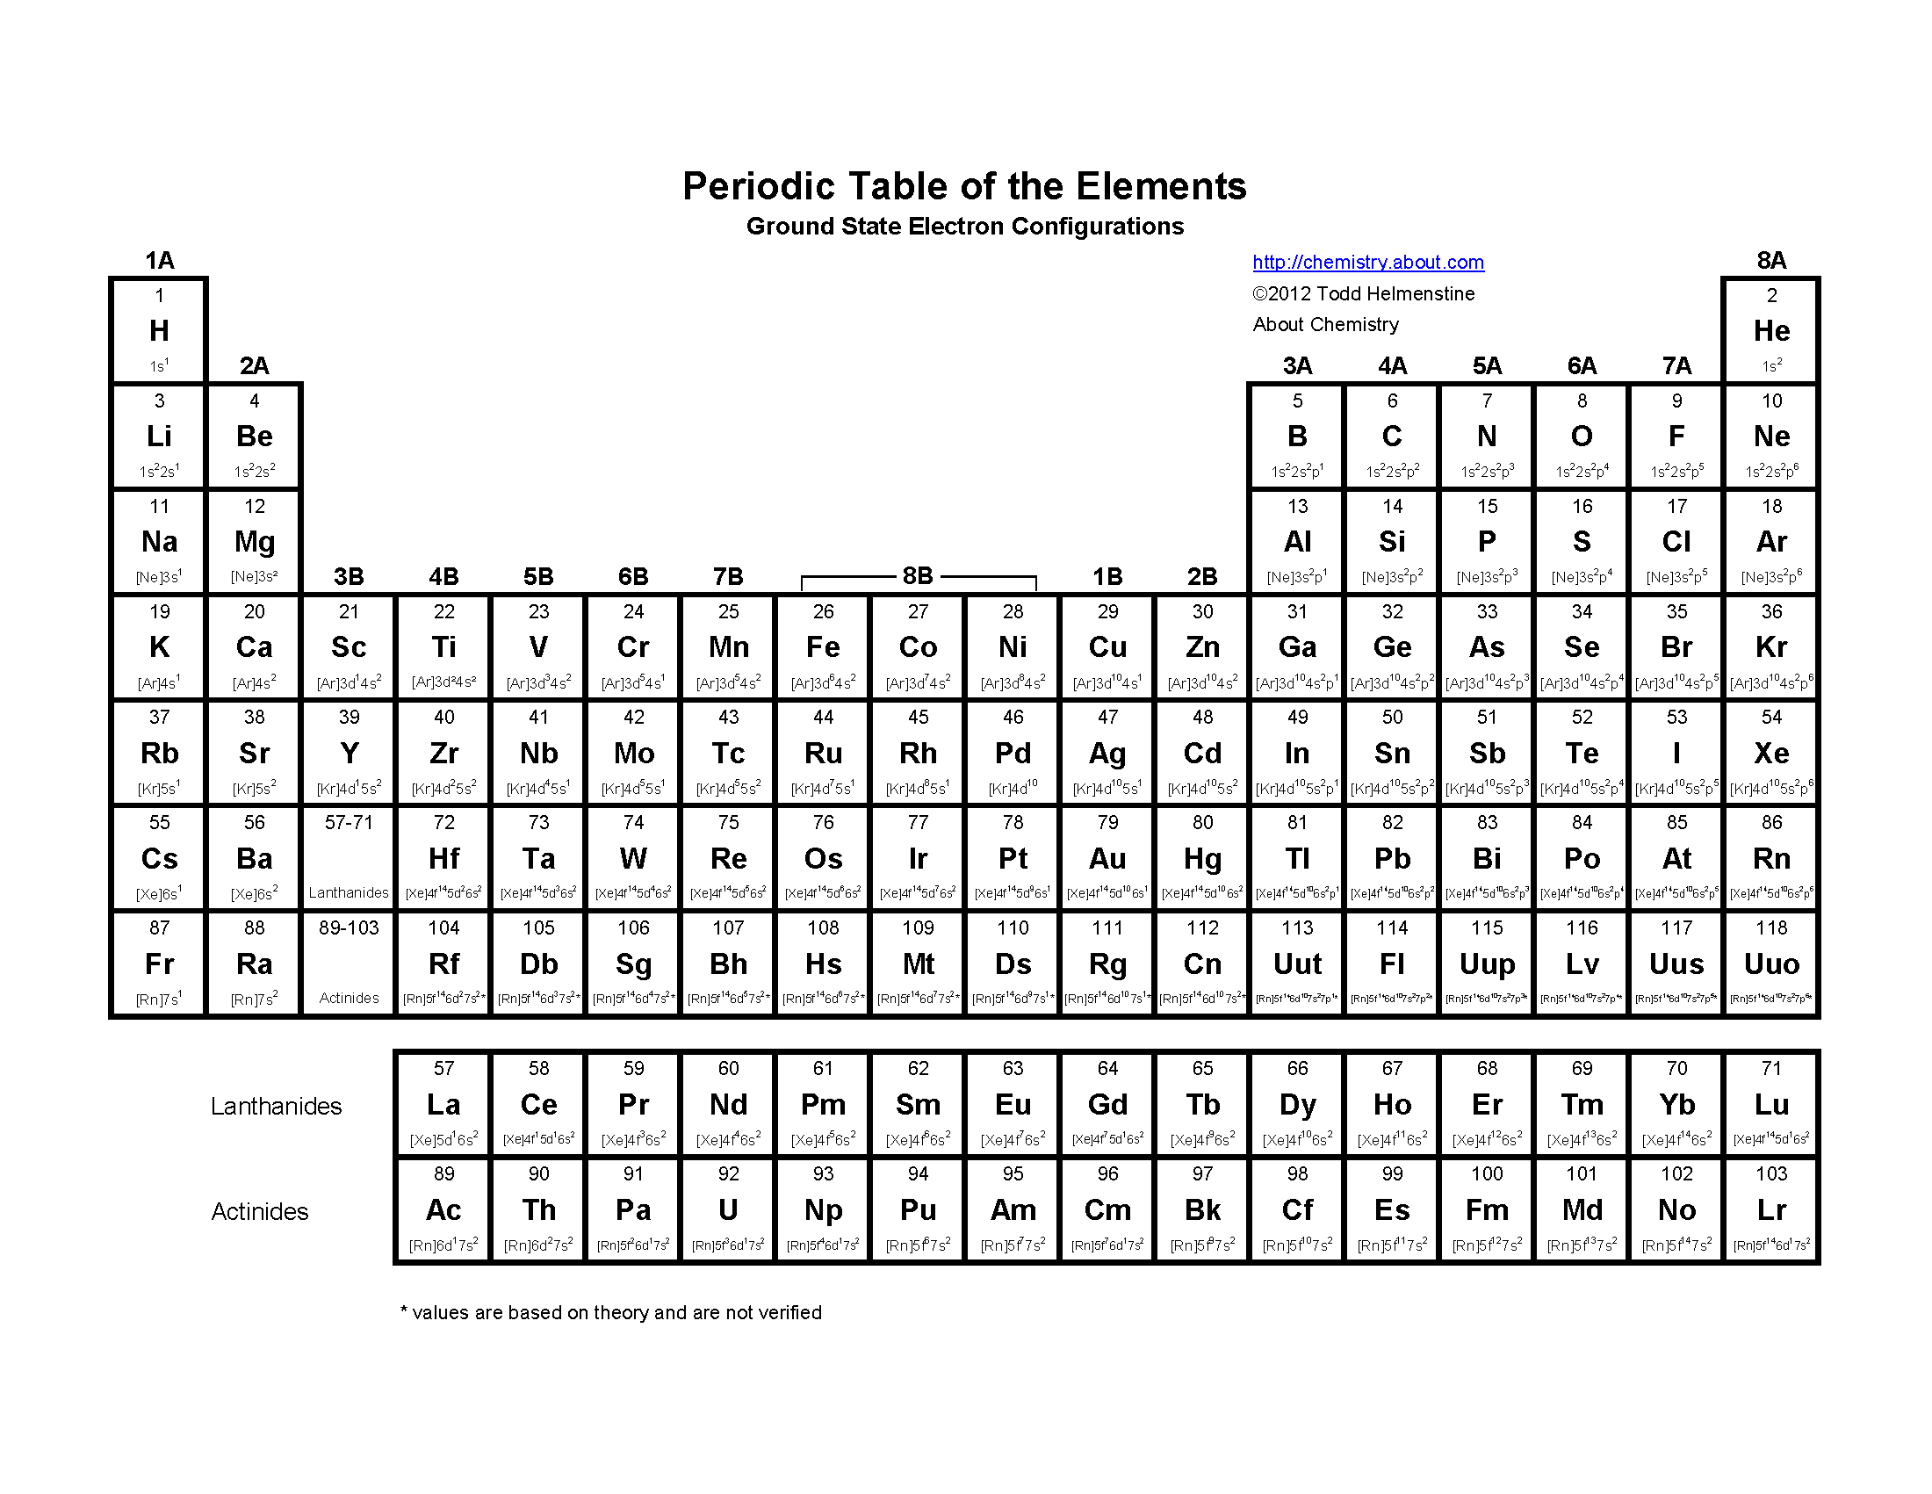
Periodic Table
8 e-
4 e-

Slide 2
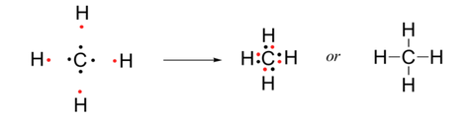


Octet Rule
Rule of thumb: Atoms tend to combine in such a way that they have EIGHT electrons in their valence shell giving them the same electron configuration as a noble gas
“lone pair”

Slide 3
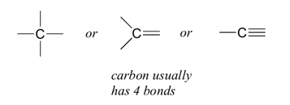
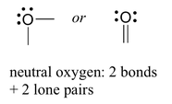
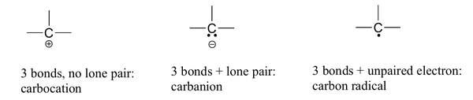
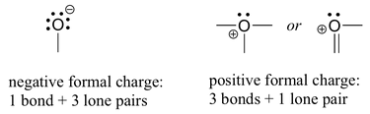
Common Bond Patterns
Carbon
Aromatic Rings
Oxygen
equivalent

Slide 4
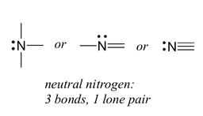
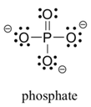
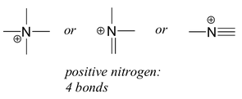
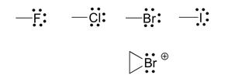
Common Bond Patterns
Nitrogen
Phosphate
Halogens

Slide 5
Drawing Line Structure
 | Lewis Structure | Drawing Line Structure | Molecular Formula | SMILES
Example 1 |  |  | C₆H₈O | O=C1CC=CCC1
Example 2 |  |  | C₄H₁₁NO | CC(O)CCN
Example 3 |  |  | C₈H₈ | c1ccccc1C=C

Slide 6
Why not use the molecular formula?
An illustrative example: C₂H₆O
CCO
COC

Slide 7

SMILES
http://en.wikipedia.org/wiki/Simplified_molecular-input_line-entry_system
SMILES = “Simplified Molecular-Input Line-Entry System”, (developed mid 1980s)
defacto standard “owned” by Daylight (http://www.daylight.com/dayhtml/doc/theory/theory.smiles.html)
Windows file extension: “.smi”
Aim: represent molecules in a compact form by a character string (“line notation”) that can be easily created, stored and converted into 2D or 3D representations (tools: openbabel, jmol, …)
Idea: think of a molecule as a graph where the vertices are atoms (but with all H atoms removed) and the edges are bonds; traverse graph and write down vertices while ignoring edges (unless they are multiple bonds)
Notation for atoms: chemical symbol in square brackets, e.g. [Ag]; usually omitted for “organic subset” (B, C, N, O, P, S, F, Cl, Br, I) ; charges indicated by n+/-, e.g. [OH-] hydroxyl anion; for aromatic C, O, S and N use lower case
Notation for bonds: only for multiple bonds; indicate type by '=‘ (double bond), '#‘ (triple), and '$‘ (quadruple), e.g. O=C=O, carbon dioxide, CO₂
Notation for rings: use numeric index as closure labels, e.g. (cycloohexane, C₆H₁₂): C1CCCCC1
Notation for branching: enclose branch in parentheses, e.g. (acetone, C₃H₆O): CC(=O)C
“Unique” or “Canonical” SMILES: many different SMILES string are valid for a given molecule, e.g. CCO, OCC and C(O)C for ethanol; algorithms exist that “uniquify” a SMILES string

Slide 8

SD(F) Format
http://en.wikipedia.org/wiki/Chemical_table_file
SD(F) = S(tructure) D(ata) (File)
Created by MDL in early 1980s (now Symyx , now owned by Accelrys, http://accelrys.com)
One (of many) formats to store 3D coordinates + connectivity info of multiple molecules + additional compound properties
Windows file extension: “.sd” or “.sdf”
Extension of “molfile” (“.mol”) format (used to store 3D coordinates + connectivity info of a single molecule)
Contents (’$$$$’ is molecule separator):
molfile1
$$$$
molfile2
$$$$
…
Other formats are: “.mol2”, “.pdb”, “.cml”, …

Slide 9
Line Structure
 | Lewis Structure | Line Structure | Molecular Formula | SMILES
Example 1 |  |  | C₆H₈O | O=C1CC=CCC1
Example 2 |  |  | C₄H₁₁NO | CC(O)CCN
Example 3 |  |  | C₈H₈ | c1ccccc1C=C

Slide 10
Bringing it to polymers

Slide 11
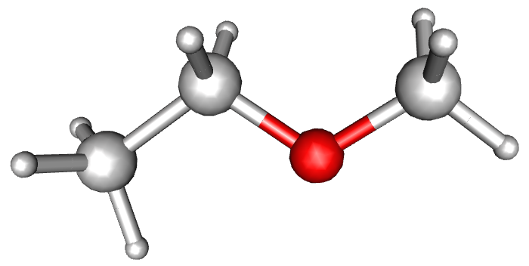
A Mockup: PEG (polyethyleneglycol) with 1 repeat unit
H10
H9
H8
H11
C2
C4
H5
O3
H12
H7
C4
H6
1

Slide 12
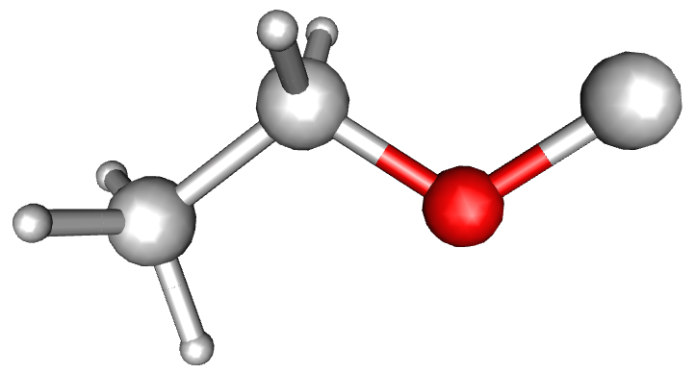
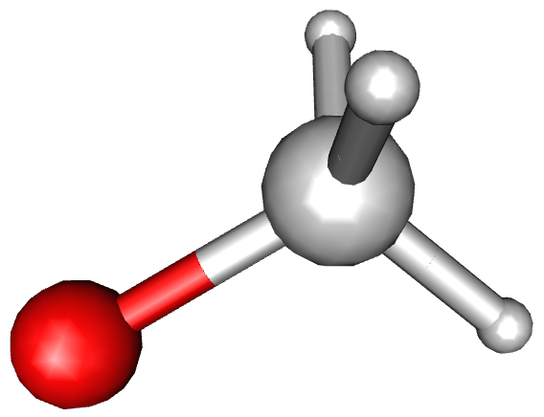
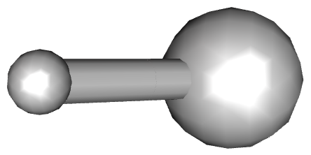
H9
H8
C2
X2
H5
C4
O3
X1
H10
H11
H6
C4
H7
X1
X2
H12
endgroup 1 (EG1) repeat unit (RU) endgroup 2 (EG2)
SMILES:
HX1 X1CCOX2 X2C

Slide 13
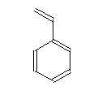
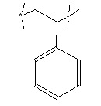
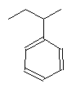
Polystyrene
 | Monomer | Polymer | Brackets Removed | X_{n} Notation for Polymer
Structure
OSRA |  | Note: the brackets are seen as bonds
SMILES | C=Cc1ccccc1 |  | CCC(C)c1ccccc1 | EG 1: CX1 RU: X1CC(X2)c1ccccc1 EG2: X2C
This is NOT what we want!

Slide 14
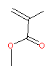
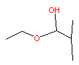
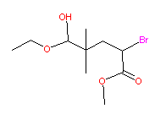
Poly methylacrylate
 | Monomer | Polymer | Brackets Removed | X_{n} Notation for Polymer
Structure
OSRA
SMILES | C=C(C)C(=O)OC |  | CCOC(O)C(C)(C)CC(Br)C(=O)OC | EG1: CCOC(=O)C(C)(C)X1 RU: X1CC(X2)C(=O)OC EG2: X2Br
This is NOT what we want!

Slide 15
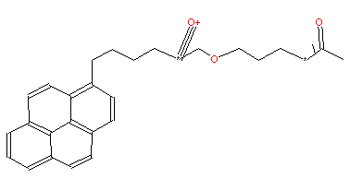

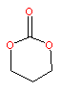
Polycarbonate
 | Monomer | Polymer | Brackets Removed | X_{n} Notation for Polymer
Structure
OSRA |  | Note: the brackets are seen as bonds | Note: structure is not correct
SMILES | O=C1OCCCO1 |  | Correct Smile String: CC(=O)OCCCOC(=O)OCCCCc1ccc2ccc3cccc4ccc1c2c34 | EG1: X1OCCCCc1ccc2ccc3cccc4ccc1c2c34 RU: X2OCCCOC(X1)=O EG2: X2C(=O)C
This is NOT what we want!

Slide 16
Resources
http://www.epa.gov/med/Prods_Pubs/smiles.htm

Slide 17
Back up

Slide 18

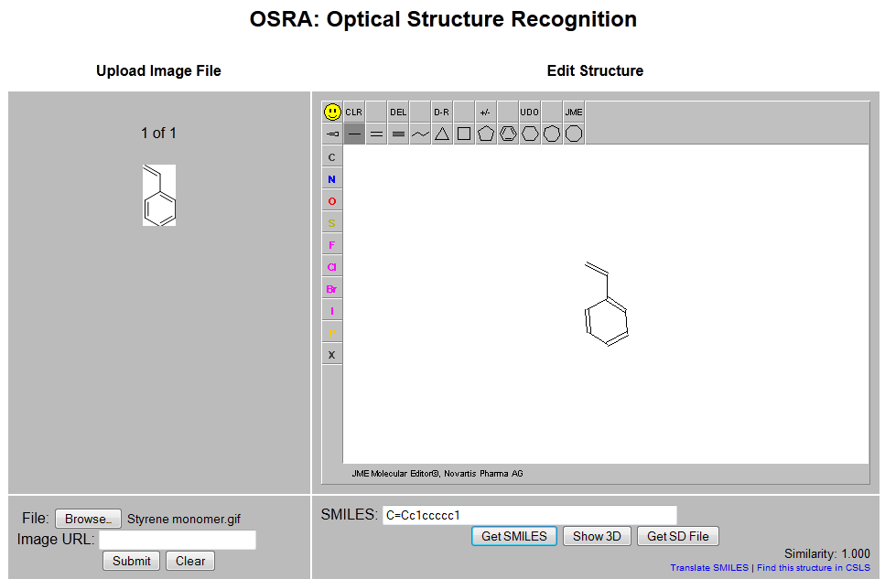
Small Molecule Example
Gif file: Styrene monomer.gif

Slide 19

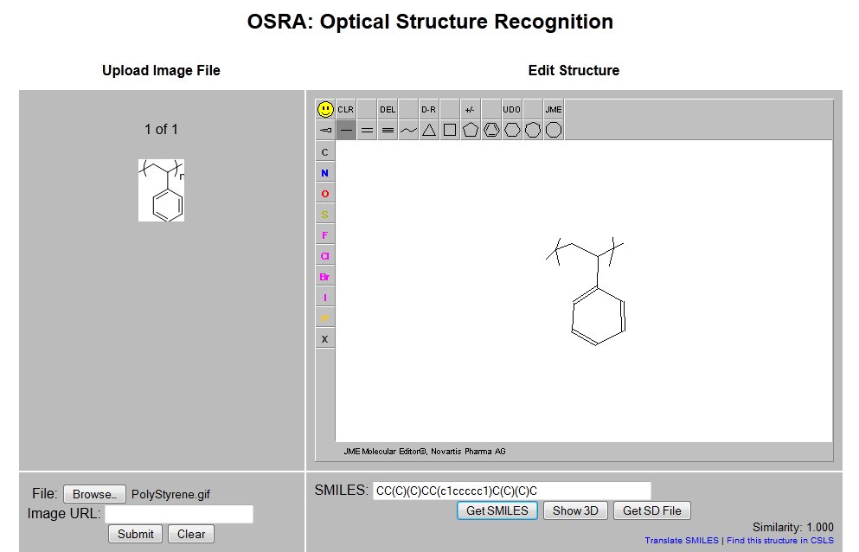
Polymer Example
Gif file: Polystyrene.gif

